Slide 1
TRIVIA 330
GEORGE SONG
AHMED FATHALLA
RV PATEL

Slide 2
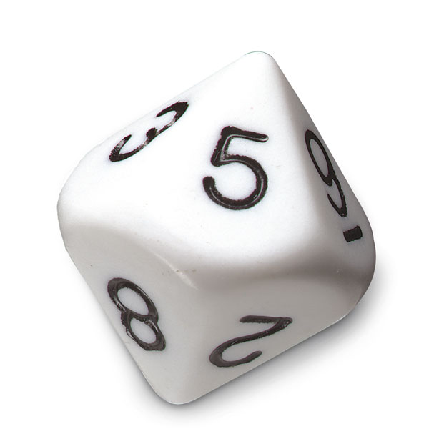
Categories
1 – Art
2 – Entertainment
3 – General
4 – Movies & Tv shows
5 – History
6 – Sport
7 – Computer Science
RANDOMIZER =
8 || 9 - >>>LUCKY CHANCE<<<

Slide 3
Description
Total of 12 questions per round
1 point for each correct answer, BONUS points (5) are given when player gets 3 consecutive correct answers
Player gets to choose the category for the first question
Lucky Chance 22%
Classes:
TriviaGame.Java
Question.Java
Player.Java

Slide 4
CODE INFORMATION
3 CLASSES
504 LINES
25 METHODS
6 LIBRARIES

Slide 5
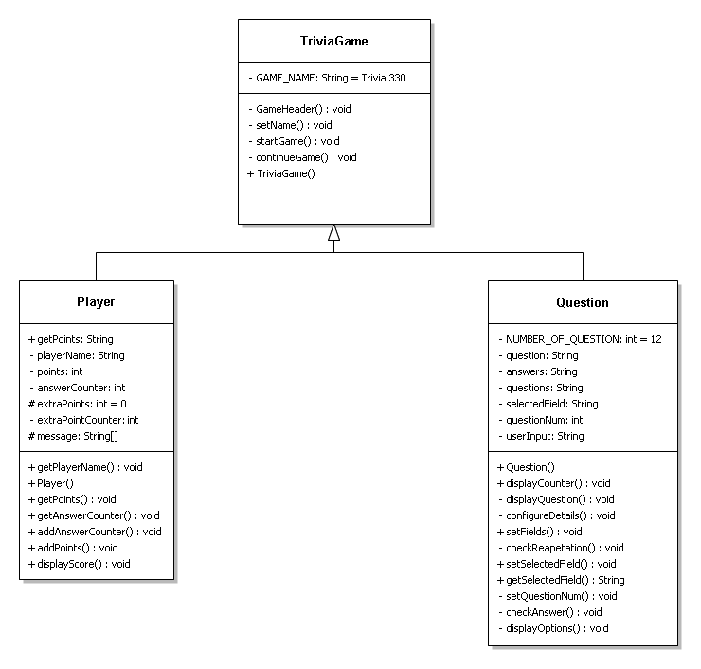
UML

Slide 6
TRIVIA
Responsible for starting the game.
Set’s Player name by using the Player class.
Displays Player’s name and points.

Slide 7
PLAYER
Gathering user’s information such as:-
Player’s Name
Player’s Points

Slide 8
QUESTION
Heavy Lifting is done by the Question class such as:-
Displaying random questions with the use of Randomizer class.
Showing options by using the String Tokenizer class.
Checking the user’s input to ensure that it’s error free.
Checks for redundancy throughout the entire code by using an List .

Slide 9
Now it’s your turn !!!!!
Each player gets to answer 3 questions .
If three or two answers are correct , you get awarded ;)
Note: There’re only 12 questions.

